Slide 1
Spreadsheet
A spreadsheet is a large sheet having data and information arranged in rows and columns.
Excel is one of the most widely used spreadsheet applications. It is a part of Microsoft Office suite.
Spreadsheet is quite useful in entering, editing, analysing and storing data.
Arithmatic operations with numerical data such as addition, subtraction, multiplication and division can be done using Excel. You can sort numbers/ characters according to some given criteria (like ascending, descending etc.) and use simple financial, mathematical and statistical formulas.

Slide 2
FEATURES OF SPREADSHEETS
There are a number of features that are available in Excel to make your task easier. Some of the main features are:
1. AutoSum - helps you to add the contents of a cluster of adjacent cells.
2. List AutoFill - automatically extends cell formatting when a new item is added to the end of a list.
3. AutoFill - allows you to quickly fill cells with repetitive or sequential data such as chronological dates or numbers, and repeated text. AutoFill can also be used to copy functions. You can also alter text and numbers with this feature.

Slide 3
FEATURES OF SPREADSHEETS
4. AutoShapes toolbar will allow you to draw a number of geometrical shapes, arrows, flowchart elements, stars and more. With these shapes you can draw your own graphs.
5. Wizard - guides you to work effectively while you work by displaying various helpful tips and techniques based on what you are doing.
6. Drag and Drop - it will help you to reposition the data and text by simply dragging the data with the help of mouse.
7. Charts - it will help you in presenting a graphical representation of your data in the form of Pie, Bar, Line charts and more.

Slide 4
FEATURES OF SPREADSHEETS
8. PivotTable - it flips and sums data in seconds and allows you to perform data analysis and generating reports like periodic financial statements, statistical reports, etc. You can also analyse complex data relationships graphically.
9. Shortcut Menus - the commands that are appropriate to the task that you are doing will appear by clicking the right mouse button

Slide 5
The Excel Interface
After starting Excel, you will see two windows - one within the other. The outer window is the Application Window and the inner window is the Workbook Window. When maximized, the Excel Workbook Window blends in with the Application Window.

Slide 6
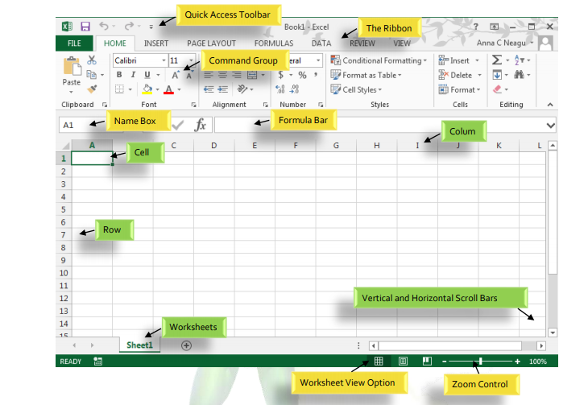

Slide 7
The Application Window
The Application Window provides the space for your worksheets and workbook elements such as charts. The components of the Application Window are described below:
  The Quick Access Toolbar:
    The Quick Access Toolbar lets you access common commands no matter which tab is selected. By default, it includes the Save, Undo, and Repeat commands. You can add other commands depending on your preference.

Slide 8
The Application Window
  The Ribbon:
    Excel uses a tabbed Ribbon system instead of traditional menus. The Ribbon contains multiple tabs, each with several groups of commands. You will use these tabs to perform the most common tasks in Excel.
  The Formula Bar:
    In the formula bar, you can enter or edit data, a formula, or a function that will appear in a specific cell.
  The Name Box:
    The Name box displays the location, or "name" of a selected cell.

Slide 9
The Workbook Window
There can be a max of 1,048,576 rows and 16,384 columns in an excel work sheet.
  The Worksheet:
    Excel files are called workbooks. Each workbook holds one or more worksheets (also known as "spreadsheets").
    Whenever you create a new Excel workbook, it will contain one worksheet named Sheet1. A worksheet is a grid of columns and rows where columns are designated by letters running across the top of the worksheet and rows are designated by numbers running down the left side of the worksheet.

Slide 10
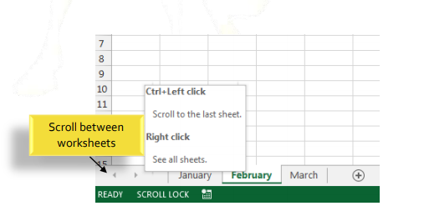
The Workbook Window
  The Scrolling Buttons:
    These buttons scroll the display of sheet tabs one at a time or to display the first and last grouping of sheet tabs and are located to the left of the sheet tabs

Slide 11
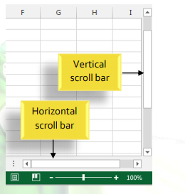
The Workbook Window
  The Scroll Bars:
    Your spreadsheet may frequently have more data than you can see on the screen at once. Click, hold and drag the vertical or horizontal scroll bar depending on what part of the page you want to see.

Slide 12
Renaming a worksheet
Whenever you create a new Excel workbook, it will contain worksheet named Sheet1,Sheet2 etc. You can rename a worksheet to better reflect its content.
Right-click the worksheet you wish to rename, then select Rename from the worksheet menu.
Type the desired name for the worksheet.
Click anywhere outside of the worksheet, or press Enter on your keyboard. The worksheet will be renamed.

Slide 13
Insert a new worksheet
Locate and select the New Sheet button/ Insert Worksheet.
A new blank worksheet will appear.
The shortcut key to insert a new worksheet is: SHIFT + F11.

Slide 14
Delete a worksheet
Right-click the worksheet you wish to delete, then select Delete from the worksheet menu.
The worksheet will be deleted from your workbook.

Slide 15
Copy a worksheet
If you need to duplicate the content of one worksheet to another, Excel allows you to copy an existing worksheet
Right-click the worksheet you want to copy, then select Move or Copy from the worksheet menu.
The Move or Copy dialog box will appear. Choose where the sheet will appear in the Before sheet: field.
Check the box next to Create a copy, then click OK.
The worksheet will be copied. It will have the same title as the original worksheet, as well as a version number.

Slide 16
Changing the worksheet color
You can change a worksheet's color to help organize your worksheets and make your workbook easier to navigate.
Right-click the desired worksheet, and hover the mouse over Tab Color. The Color menu will appear.
Select the desired color. A live preview of the new worksheet color will appear as you hover the mouse over different options.
The worksheet color will be changed.

Slide 17
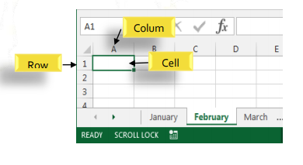
Cells
Whenever you work with Excel, you'll enter information, or content, into cells. Cells are the basic building blocks of a worksheet.
Every worksheet is made up of thousands of rectangles, which are called cells. A cell is the intersection of a row and a column. Columns are identified by letters (A, B, C), while rows are identified by numbers (1, 2, 3).

Slide 18
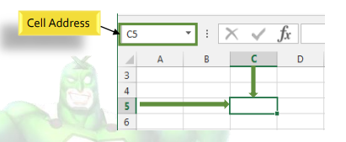
Cells
Each cell has its own name, or cell address, based on its column and row. In this example, the selected cell intersects column C and row 5, so the cell address is C5. The cell address will also appear in the Name box.

Slide 19
Cell
You can also select multiple cells at the same time. A group of cells is known as a cell range. Rather than a single cell address, you will refer to a cell range using the cell addresses of the first and last cells in the cell range, separated by a colon. For example, a cell range that included cells A1, A2, A3, A4, and A5 would be written as A1:A5.

Slide 20
Cell Content
Any information you enter into a spreadsheet will be stored in a cell. Each cell can contain several different kinds of content, including text, formatting, formulas, and functions.
  Text: Cells can contain text, such as letters, numbers, and dates.
  Formatting Attributes: Cells can contain formatting attributes that change the way letters, numbers, and dates are displayed. For example, percentages can appear as 0.15 or 15%. You can even change a cell's background color.
  Formulas and Functions: Cells can contain formulas and functions that calculate cell values.

Slide 21
Use of fill handle
There may be times when you need to copy the content of one cell to several other cells in your worksheet. You could copy and paste the content into each cell, but this method would be very time consuming. Instead, you can use the fill handle to quickly copy and paste content to adjacent cells in the same row or column.

Slide 22
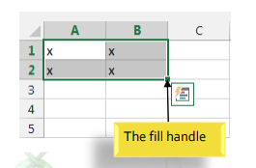
Use of fill handle
Select the cell(s) containing the content you wish to use. The fill handle will appear as a small square in the bottom-right corner of the selected cell(s).
Click, hold, and drag the fill handle until all of the cells you wish to fill are selected.
Release the mouse to fill the selected cells.

Slide 23
To continue a series with the fill handle
The fill handle can also be used to continue a series. Whenever the content of a row or column follows a sequential order, like numbers (1, 2, 3) or days (Monday, Tuesday, Wednesday), the fill handle can guess what should come next in the series.

Slide 24
Formatting Cells
Font Formatting:
  By default, the font of each new workbook is set to Calibri. However, Excel provides a variety of other fonts you can use to customize your cell text.

Slide 25
Formatting Cells
Text Alignment
  By default, any text entered into your worksheet will be aligned to the bottom-left of a cell.
  Any numbers will be aligned to the bottom-right of a cell.
  Changing the alignment of your cell content allows you to choose how the content is displayed in any cell, which can make your cell content easier to read.

Slide 26
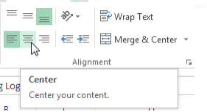
Formatting Cells
To change horizontal text alignment:
  Select the cell(s) you wish to modify.
  Select one of the three horizontal alignment commands on the Home tab. In our example, we'll choose Center Align.
  The text will realign.

Slide 27
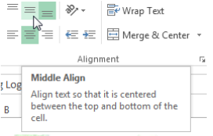
Formatting Cells
To change vertical text alignment
  Select the cell(s) you wish to modify.
  Select one of the three vertical alignment commands on the Home tab.
  The text will realign.

Slide 28
Formatting Cells
Cell borders and fill colors:
  Cell borders and fill colors allow you to create clear and defined boundaries for different sections of your worksheet.
To add a border:
  Select the cell(s) you wish to modify.
  Click the drop-down arrow next to the Borders command on the Home tab. The Borders dropdown menu will appear.
  Select the border style you want to use.
  The selected border style will appear.

Slide 29
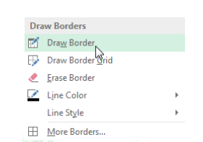
Formatting Cells
You can draw borders and change the line style and color of borders with the Draw Borders tools at the bottom of the Borders drop-down menu.

Slide 30
Formatting Cells
To add a fill color:
  Select the cell(s) you wish to modify.
  Click the drop-down arrow next to the Fill Color command on the Home tab. The Fill Color menu will appear.
  Select the fill color you want to use. A live preview of the new fill color will appear as you hover the mouse over different options.
  The selected fill color will appear in the selected cells.

Slide 31
Formatting Cells
Formatting text and numbers:
  In Excel ,you can apply specific formatting for text and numbers. Instead of displaying all cell content in exactly the same way, you can use formatting to change the appearance of dates, times, decimals, percentages (%), currency ($), and much more.

Slide 32
Formatting Cells
To apply number formatting:
  Select the cells(s) you wish to modify.
  Click the drop-down arrow next to the Number Format command on the Home tab. The Number Formatting drop-down menu will appear.
  Select the desired formatting option.
  The selected cells will change to the new formatting style.

Slide 33
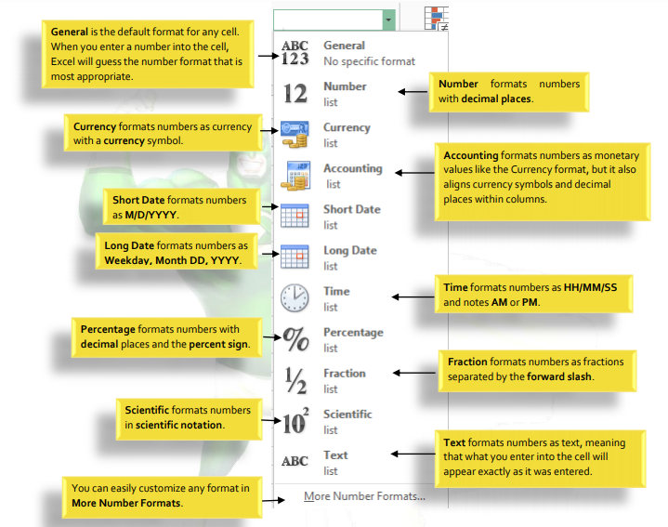

Slide 34
Modifying Columns, Rows and Cells
By default, every row and column of a new workbook is always set to the same height and width. Excel allows you to modify column width and row height in different ways, including wrapping text and merging cells.
To modify column width
  Position the mouse over the column line in the column heading so the white cross becomes a double arrow .
  Click, hold, and drag the mouse to increase or decrease the column width.
  Release the mouse. The column width will be changed.

Slide 35
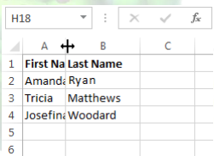
Modifying Columns, Rows and Cells
If you see pound signs (#######) in a cell, it means that the column is not wide enough to display the cell content. Simply increase the column width to show the cell content.

Slide 36
Modifying Columns, Rows and Cells
Autofit column width:
  The AutoFit feature will allow you to set a column's width to fit its content automatically.
  Position the mouse over the column line in the column heading so the white cross becomes a double arrow .
  Double-click the mouse. The column width will be changed automatically to fit the content.

Slide 37
Wrapping text and merging cells
Whenever you have too much cell content to be displayed in a single cell, you may decide to wrap the text or merge the cell rather than resizing a column.
Wrapping the text will automatically modify a cell's row height, allowing cell contents to be displayed on multiple lines.
Merging allows you to combine a cell with adjacent, empty cells to create one large cell.

Slide 38
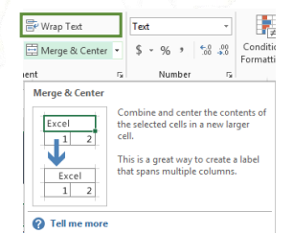
Wrapping Cells
Select the cells you wish to wrap.
Select the Wrap Text command on the Home tab.
The text in the selected cells will be wrapped.
  Click the Wrap Text command again to unwrap the text.

Slide 39
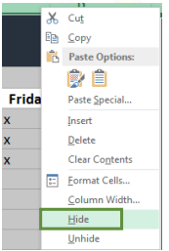
To hide and unhide a row or column
Select the column(s) you wish to hide, right-click the mouse, then select Hide from the formatting menu.
The columns will be hidden. The green column line indicates the location of the hidden columns.

Slide 40
To hide and unhide a row or column
To unhide the columns, select the columns to the left and right of the hidden columns (in other words, the columns on both sides of the hidden columns).
Right-click the mouse, then select Unhide from the formatting menu. The hidden columns will reappear.

Slide 41
Formulas and Functions
One of the most powerful features in Excel is the ability to calculate numerical information using formulas.
All formulas in Excel must begin with an equals sign (=). This is because the cell contains, or is equal to, the formula and the value it calculates.

Slide 42
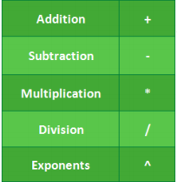
Formulas and Functions
Excel uses standard operators for formulas, such as a plus sign for addition (+), a minus sign for subtraction (-), an asterisk for multiplication (*), a forward slash for division (/), and a caret (^) for exponents

Slide 43
Cell References
While you can create simple formulas in Excel manually (for example, =2+2 or =5*5), most of the time you will use cell addresses to create a formula. This is known as making a cell reference.
Using cell references will ensure that your formulas are always accurate because you can change the value of referenced cells without having to rewrite the formula.

Slide 44
Relative and Absolute Cell References
There are two types of cell references: relative and absolute.
Relative and absolute references behave differently when copied and filled to other cells.
    Relative references change when a formula is copied to another cell.
    Absolute references, on the other hand, remain constant, no matter where they are copied.

Slide 45
Relative cell references
By default, all cell references are relative references.
When copied across multiple cells, they change based on the relative position of rows and columns.
For example, if you copy the formula =A1+B1 from row 1 to row 2, the formula will become =A2+B2.
Relative references are especially convenient whenever you need to repeat the same calculation across multiple rows or columns.

Slide 46
Absolute cell references
Unlike relative references, absolute references do not change when copied or filled. You can use an absolute reference to keep a row and/or column constant.
An absolute reference is designated in a formula by the addition of a dollar sign ($). It can precede the column reference, the row reference, or both.

Slide 47
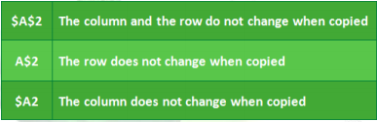
Absolute cell references
When writing a formula, you can press the F4 key on your keyboard to switch between relative and absolute cell references. This is an easy way to quickly insert an absolute reference.

Slide 48
Functions
A function is a predefined formula that performs calculations using specific values in a particular order.
Excel includes many common functions that can be useful for quickly finding the sum, average, count, maximum value, and minimum value for a range of cells.
Formula=A1+A2+A3+A4+A5+A6+A7+A8 Function =SUM(A1:A8)

Slide 49
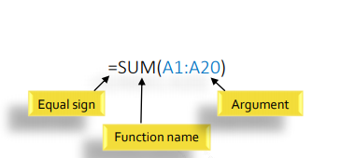
Parts of a Function
In order to work correctly, a function must be written a specific way, which is called the syntax.
The basic syntax for a function is an equals sign (=), the function name (SUM, for example), and one or more arguments. Arguments contain the information you want to calculate.

Slide 50
Functions
Arguments can refer to both individual cells and cell ranges and must be enclosed within parentheses. You can include one argument or multiple arguments, depending on the syntax required for the function.
For example, the function =AVERAGE(B1:B9) would calculate the average of the values in the cell range B1:B9. This function contains only one argument.
Multiple arguments must be separated by a comma. For example, the function =SUM(A1:A3, C1:C2, E2) will add the values of all the cells in the three arguments.

Slide 51
Functions
Excel has a variety of functions available:
SUM: This function adds all of the values of the cells in the argument.
AVERAGE: This function determines the average of the values included in the argument. It calculates the sum of the cells and then divides that value by the number of cells in the argument.
COUNT: This function counts the number of cells with numerical data in the argument. This function is useful for quickly counting items in a cell range.
MAX: This function determines the highest cell value included in the argument.
MIN: This function determines the lowest cell value included in the argument.

Slide 52
To create a function using the AutoSum command
The AutoSum command allows you to automatically insert the most common functions into your formula, including SUM, AVERAGE, COUNT, MIN, and MAX.

Slide 53
Functions
SUM :
  Formula: =SUM(5, 5) or =SUM(A1, B1) or =SUM(A1:B5)
  The SUM formula does exactly what you would expect. It allows you to add 2 or more numbers together. You can use cell references as well in this formula.

Slide 54
Functions
COUNT
  Formula: =COUNT(A1:A10)
  The count formula counts the number of cells in a range that have numbers in them.
  It only counts the cells where there are numbers.

Slide 55
Functions
COUNTA
  Formula: =COUNTA(A1:A10)
  Counts the number of non-empty cells in a range.
  It will count cells that have numbers and/or any other characters in them. The COUNTA Formula works with all data types.
  It counts the number of non-empty cells no matter the data type.

Slide 56
Functions
LEN
  Formula: =LEN(A1)
  The LEN formula counts the number of characters in a cell. This includes spaces!

Slide 57
Functions
VLOOKUP is an Excel function to lookup and retrieve data from a specific column in table.
VLOOKUP (lookup_value, table_array, col_index_num, [range_lookup])
Where
lookup_value − is the value you want to look up. Lookup_value can be a value or a reference to a cell. Lookup_value must be in the first column of the range of cells you specify in table_array
table_array − is the range of cells in which the VLOOKUP will search for the lookup_value and the return value. table_array must contain
  the lookup_value in the first column, and
  the return value you want to find

Slide 58
Functions
col_index_num − is the column number in the table_array that contains the return value. The numbers start with 1 for the left-most column of table-array
range_lookup − is an optional logical value that specifies whether you want VLOOKUP to find an exact match or an approximate match. range_lookup can be
  omitted, in which case it is assumed to be TRUE and VLOOKUP tries to find an approximate match
  TRUE, in which case VLOOKUP tries to find an approximate match. In other words, if an exact match is not found, the next largest value that is less than lookup_value is returned
  FALSE, in which case VLOOKUP tries to find an exact match
  1, in which case it is assumed to be TRUE and VLOOKUP tries to find an approximate match
  0, in which case it is assumed to be FALSE and VLOOKUP tries to find an exact match

Slide 59
Functions
IF Statements
  allows you to make logical comparisons between a value and what you expect.
  Formula: =IF(logical_statement, return this if logical statement is true, return this if logical statement is false).
  Nesting of IF statements is possible but Excel only allows this till 64 Levels.

Slide 60
Freezing Panes and View Options
To freeze rows :
  You may want to see certain rows or columns all the time in your worksheet, especially header cells. By freezing rows or columns in place, you'll be able to scroll through your content while continuing to view the frozen cells.
Select the row below the row(s) you wish to freeze.
Click the View tab on the Ribbon.
Select the Freeze Panes command, then choose Freeze Panes from the drop-down menu.

